Slide 1


React Router Introduction
PART-54
REACT
Presenter: mohammad adil

Slide 2
Pre-Requisites
Function based Components
State
Props
Arrow Functions
JSX
Hooks

Slide 3


Humble Request
Techno Verse YT
Heavenly Delicious

Slide 4
React Router
React Router is a standard library for routing in React.

Slide 5
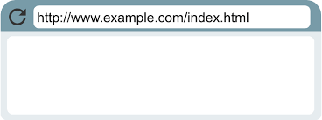
What is Routing ?
Routing is the mechanism by which requests (as specified by a URL and HTTP method) are routed to the code that handles them.
URL
Code
Executes
Page

Slide 6
What is Routing ?
URL
Code
Executes
Page1
Without
Page Reload
Code
Executes
Page2
react-router-dom

Slide 7
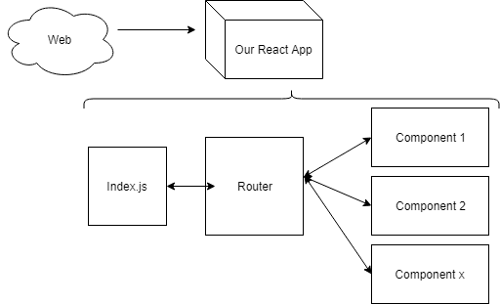

Slide 8
React Routing
It enables the navigation among views of various components in a React Application, allows changing the browser URL, and keeps the UI in sync with the URL.
React Router is a fully-featured client and server-side routing library for React, a JavaScript library for building user interfaces.
React Router runs anywhere React runs; on the web, on the server with node.js, and on React Native

Slide 9
React Routing
Create React App doesn't include page routing by default.
React Router is the most popular solution.
It provides unique URLs for different components in the app and makes UI easily shareable with other users.

Slide 10
Topics In React Routing
Configuring Routes
Navigating on button click
Navigating programmatically
Dynamic routes
Nested routes
Route Parameters
And much more.

